Slide 1
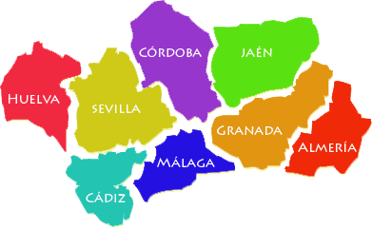
SPAIN – A TASTE OF ANDALUCIA
CORDOBA, SEVILLA, HUELVA, CADIZ, MALAGA, and GRANADA

Slide 2
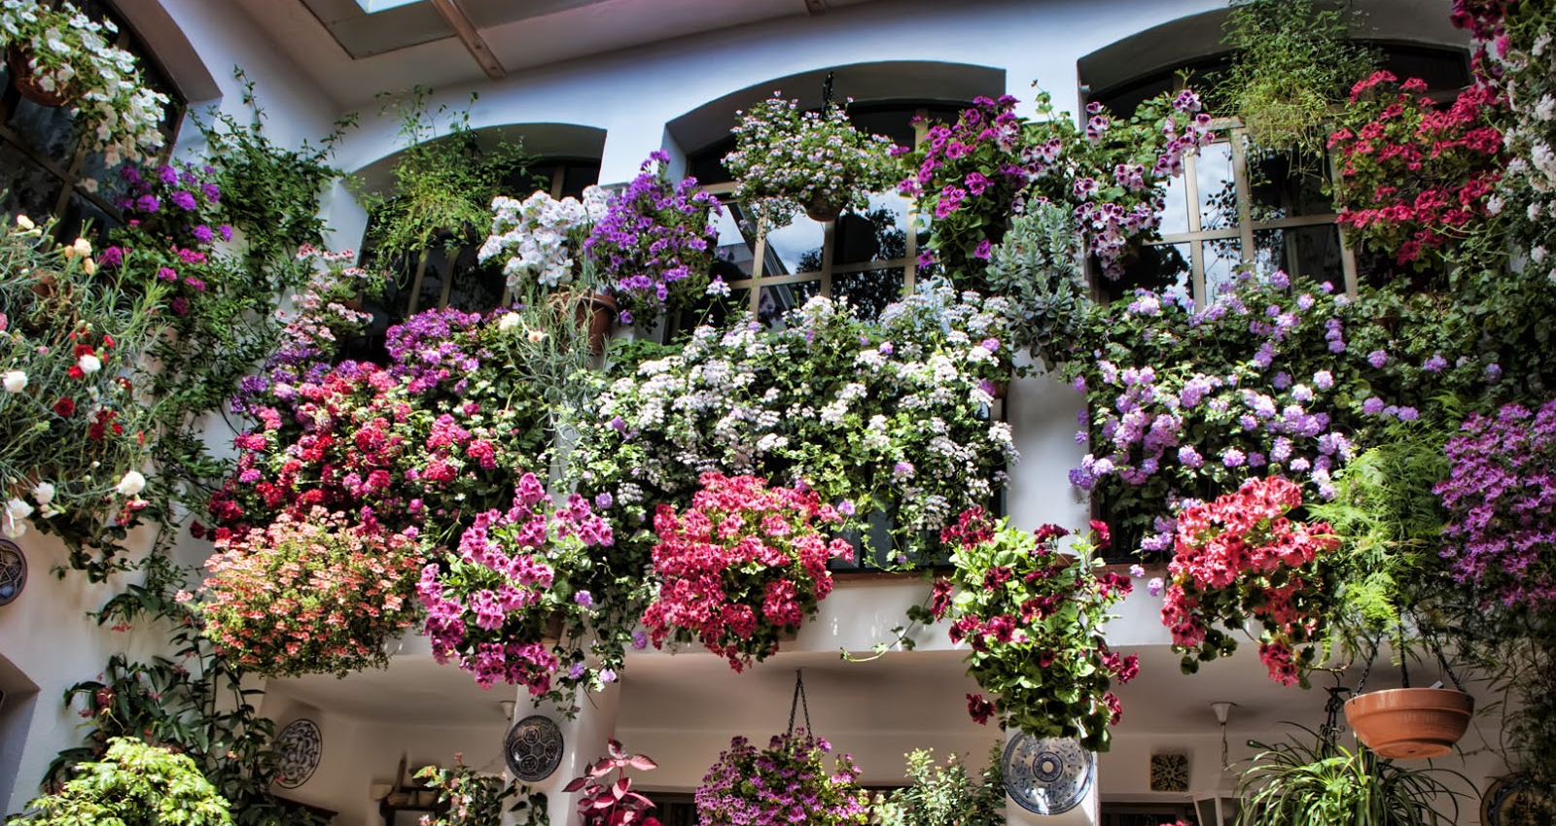
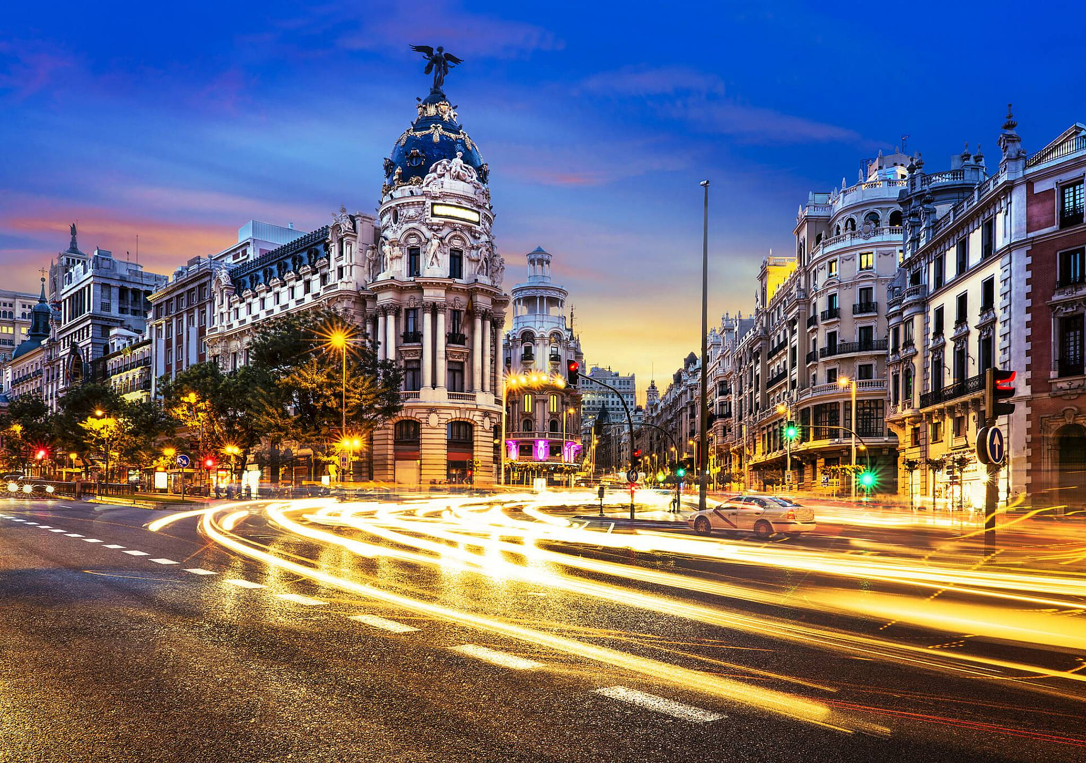
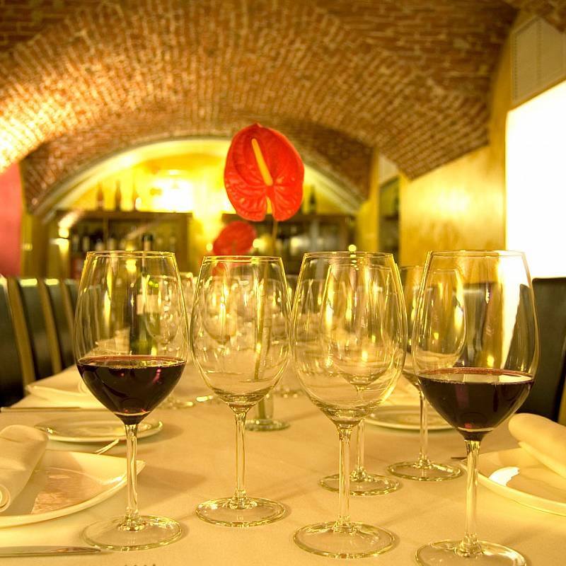
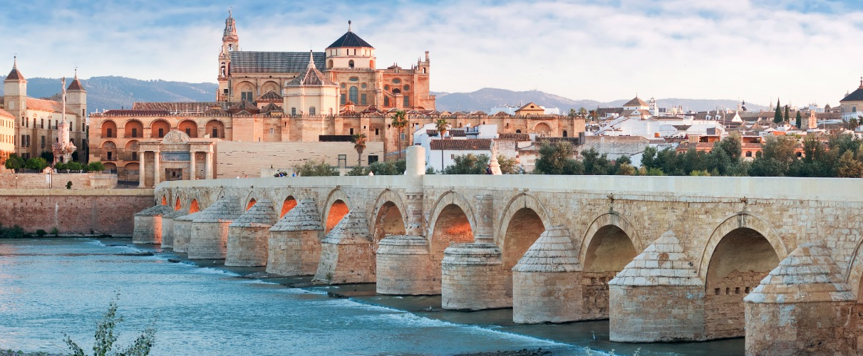
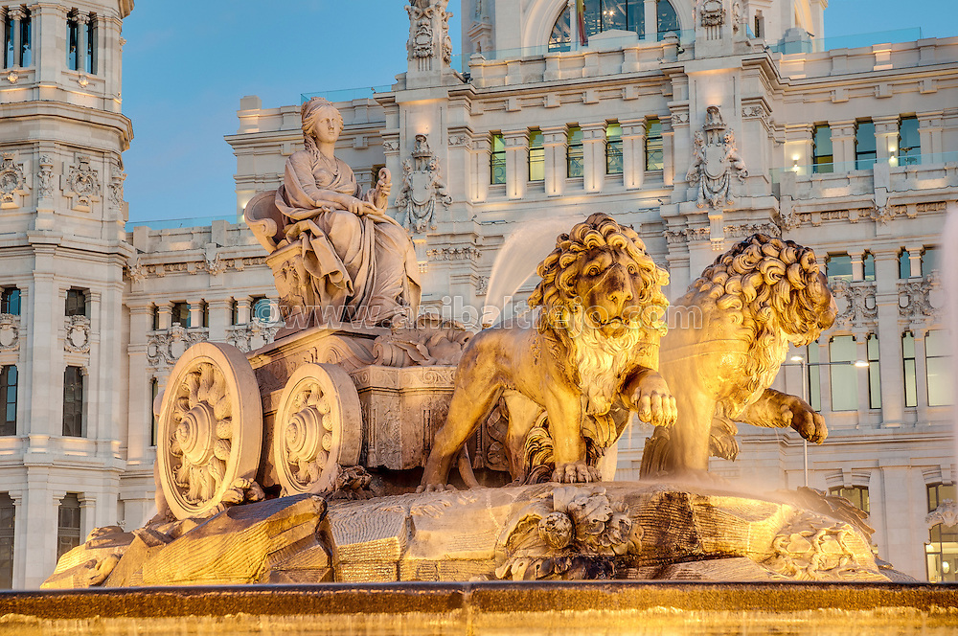
Visit Cordoba
2 Welcome!
Check into your centrally located Madrid hotel and join us for a welcome get-together of wine, beer, soft drinks and Spanish tapas.
We will brief you on what to expect during the magical Spanish experience we are embarking on.

Slide 3
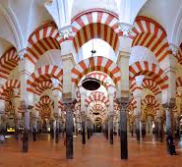
Visit Cordoba
3 Experience Cordoba
Enjoy the 190 mile an hour “bullet” train trip to Sevilla
Stop in Cordoba for tour that includes la Mezquita, one of the largest mosques in the world… with a Catholic Cathedral inside
See the lovely flowered neighborhoods of Cordoba, the Roman Bridge and the Plaza de Corredura.
Re-board train for an hours trip to Sevilla where we will take a taxi to our hotel.

Slide 4
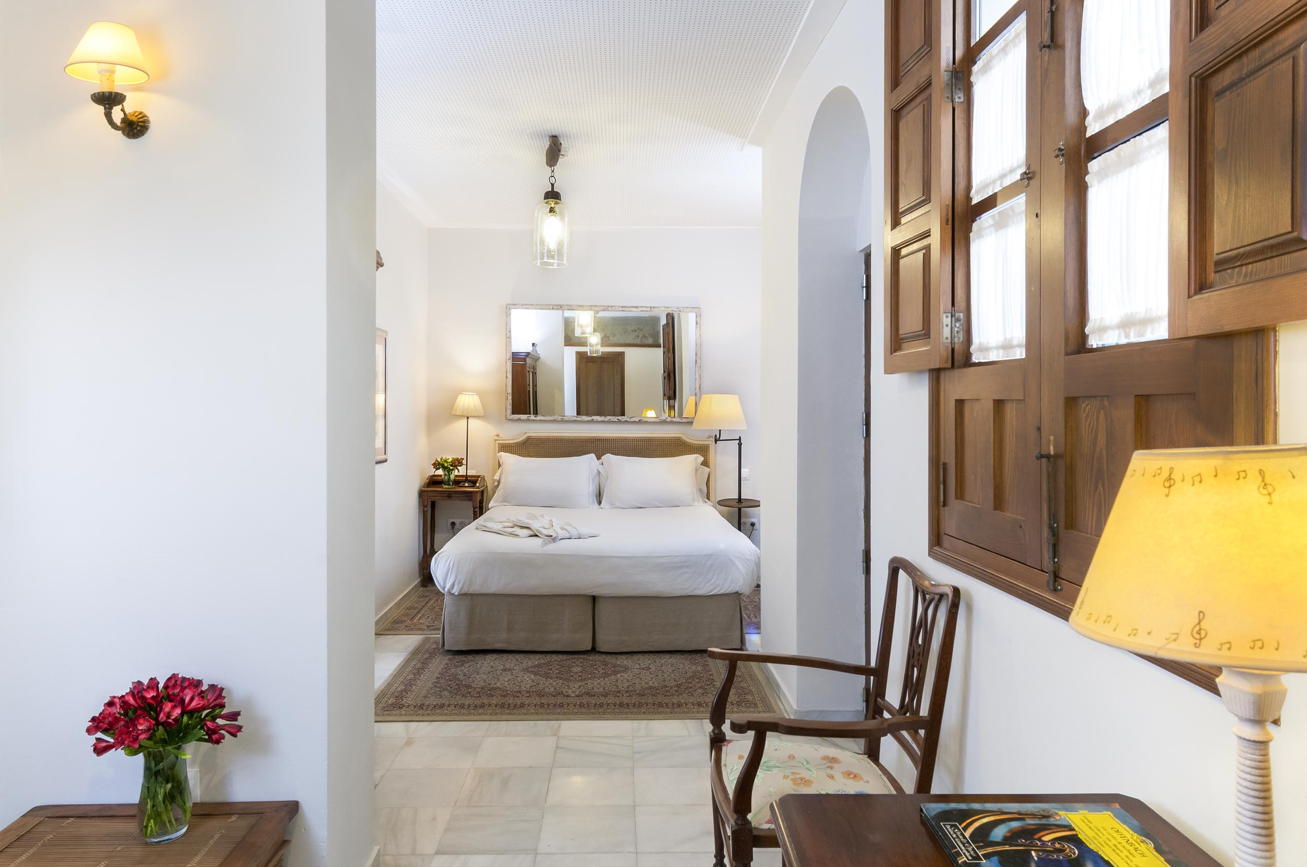
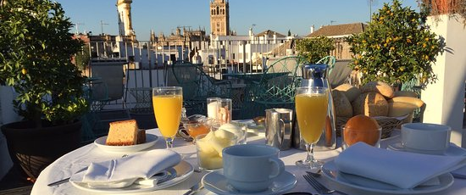
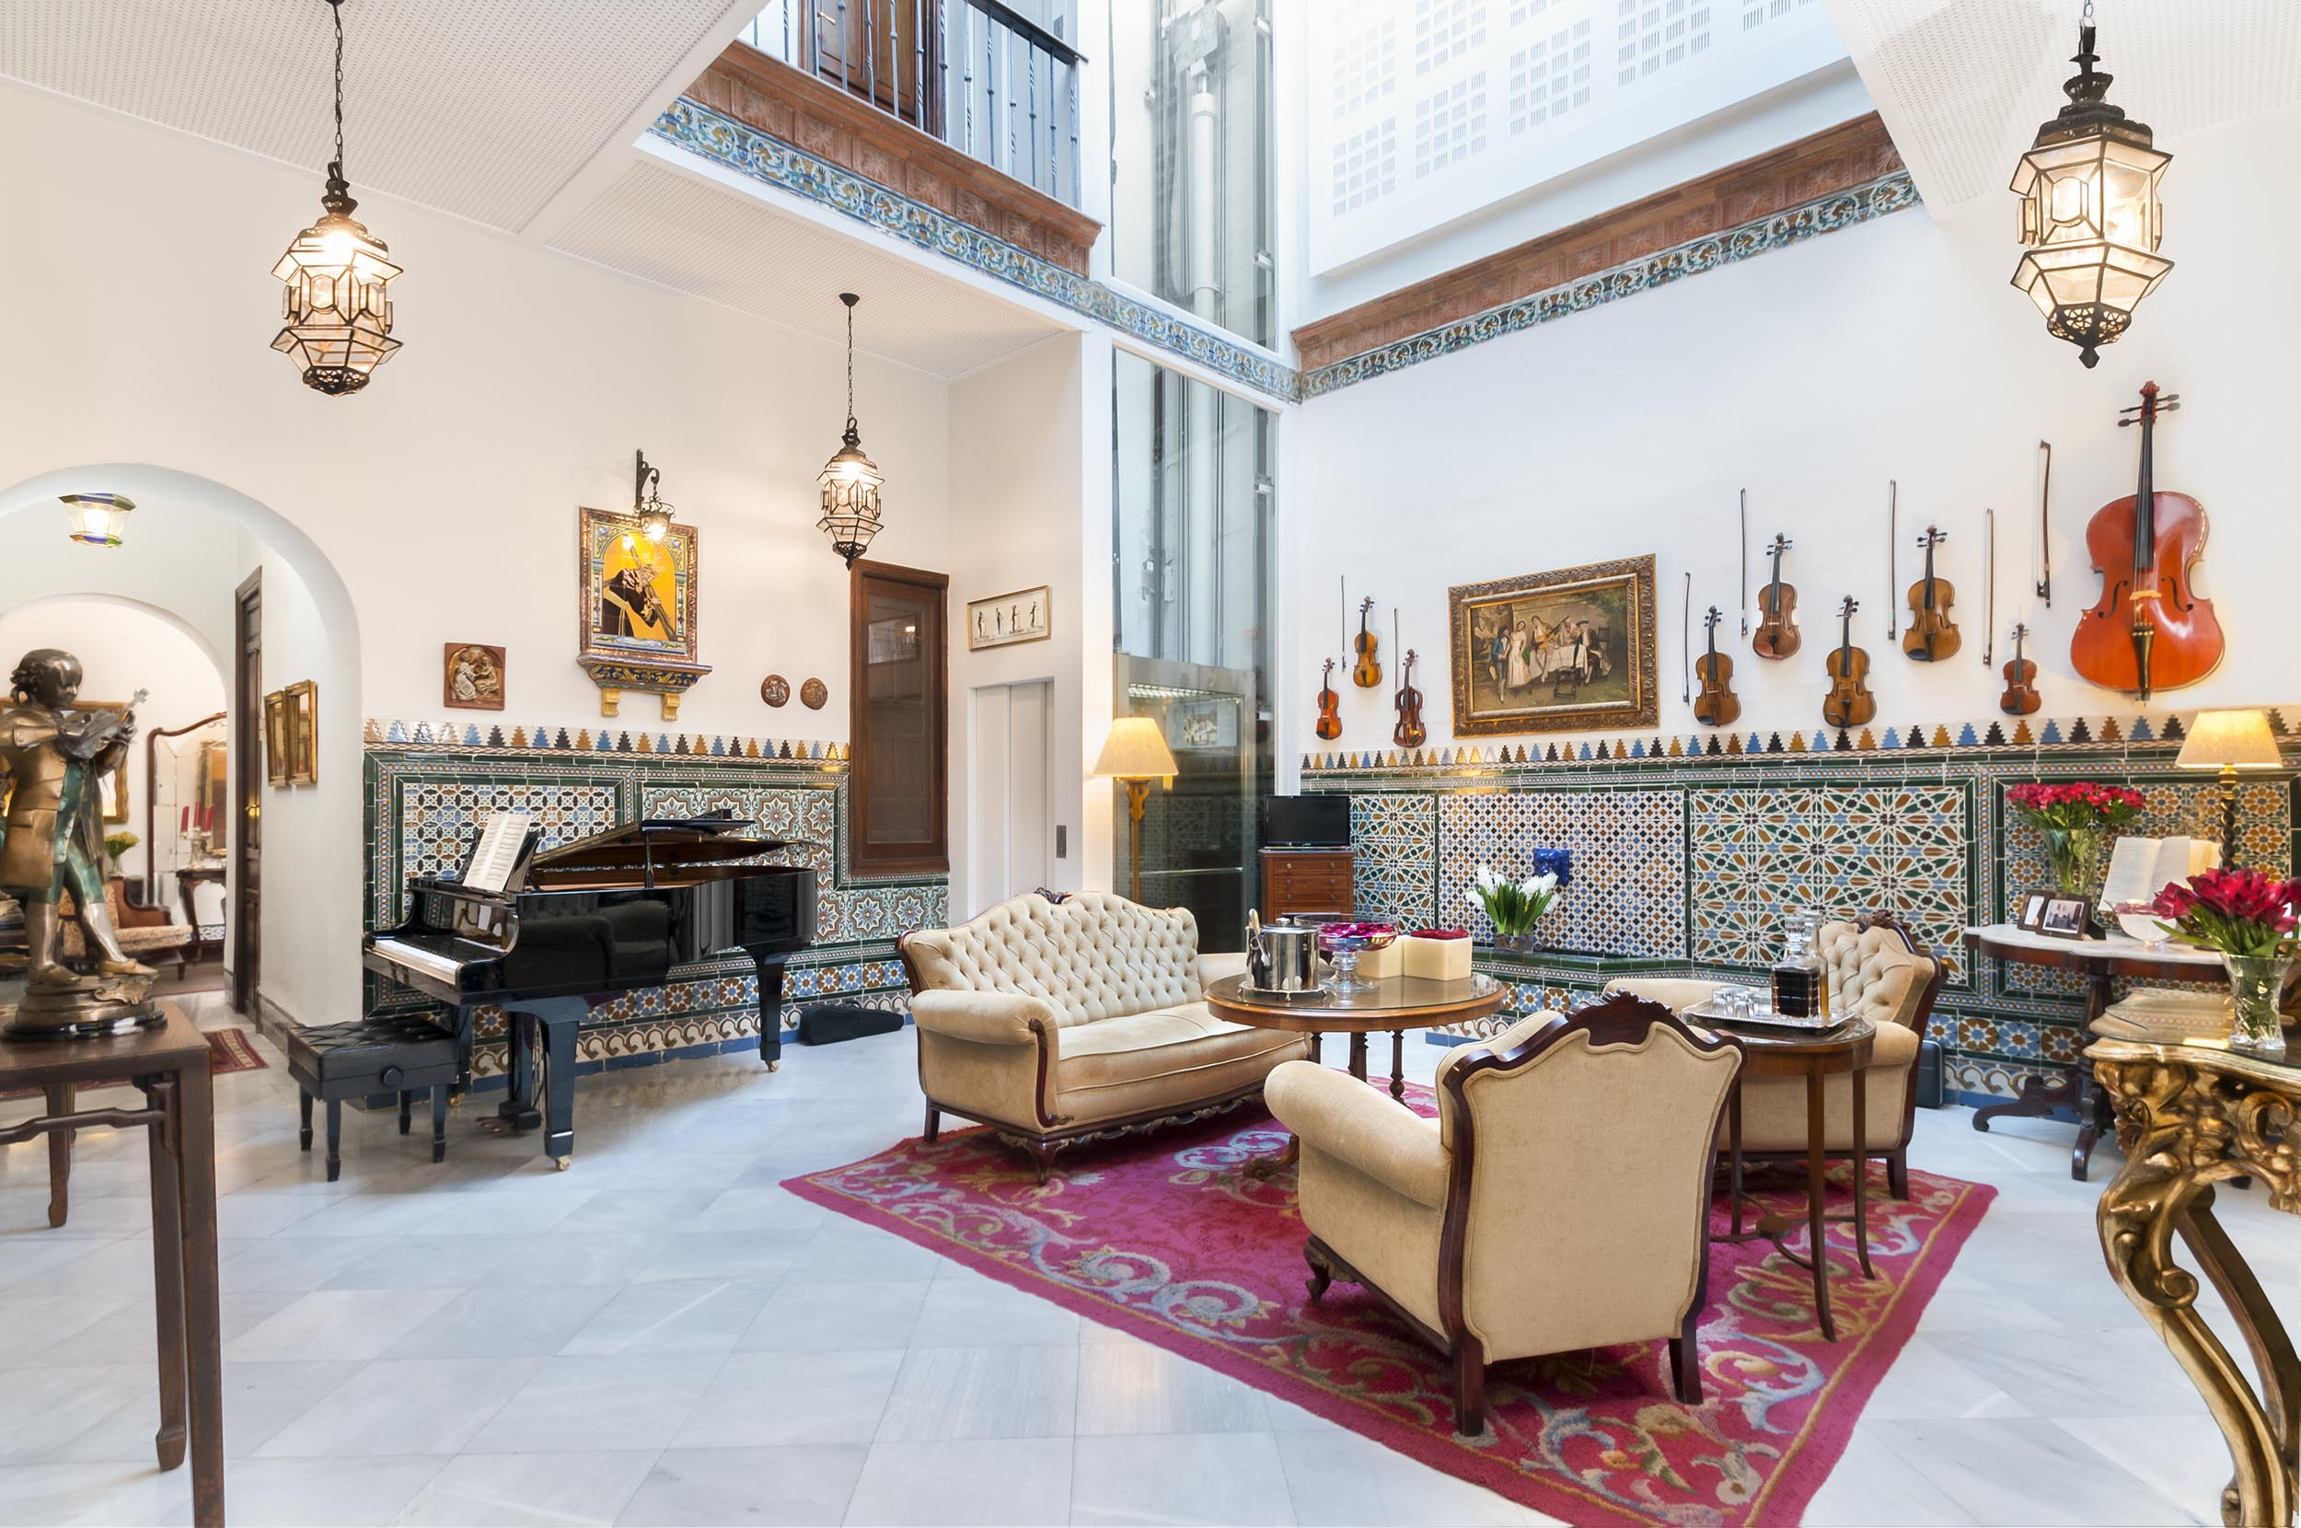
Amadeus y la musica
Amadeus y la Musica
Your lovely boutique hotel is your headquarters for your stay in Seville. It is in the heart of one of the city’s most charming neighborhoods – The Old Jewish Quarter. Relax and explore.

Slide 5
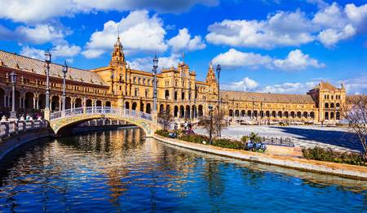
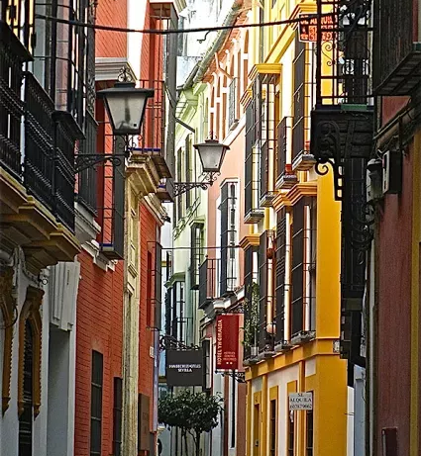
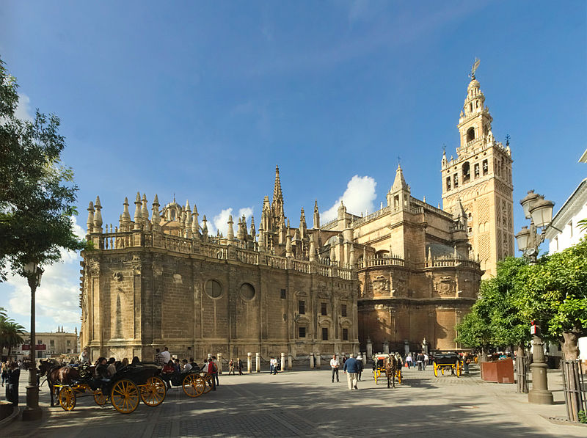
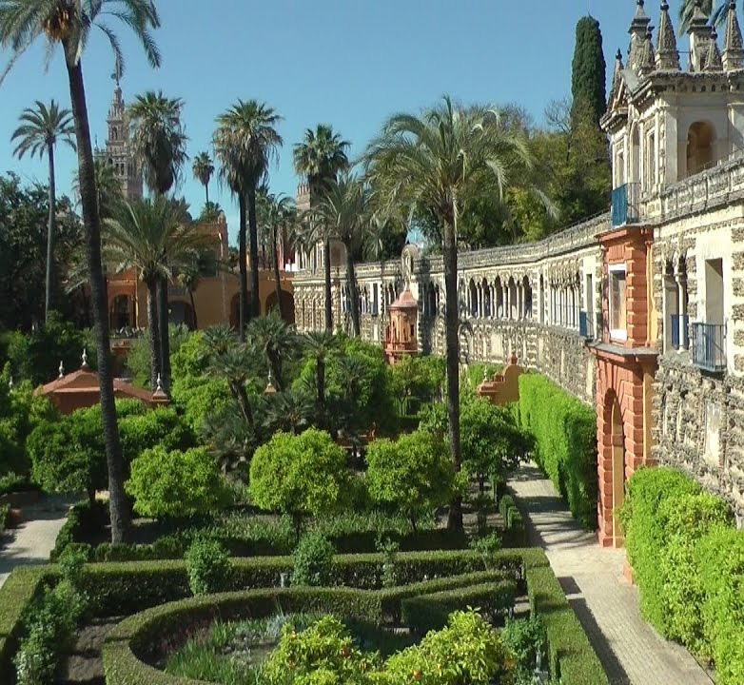
Sevilla Monumental
4 Seville’s Best
We offer a specially designed tour of Monumental Sevilla. It includes the most important sights in Sevilla, a relaxing horse drawn carriage through the lovely parks, and lunch in Triana. Or you may opt for a self-guided tour

Slide 6
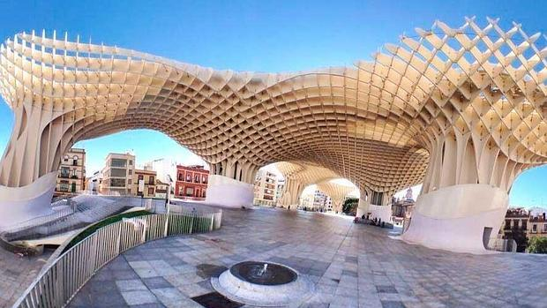
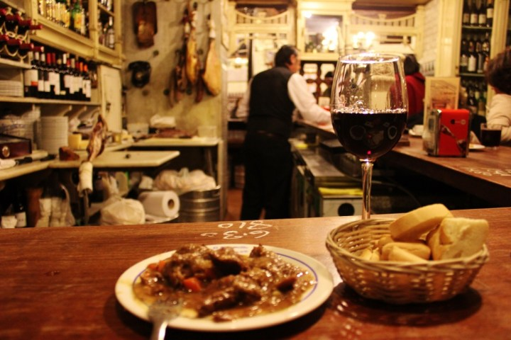
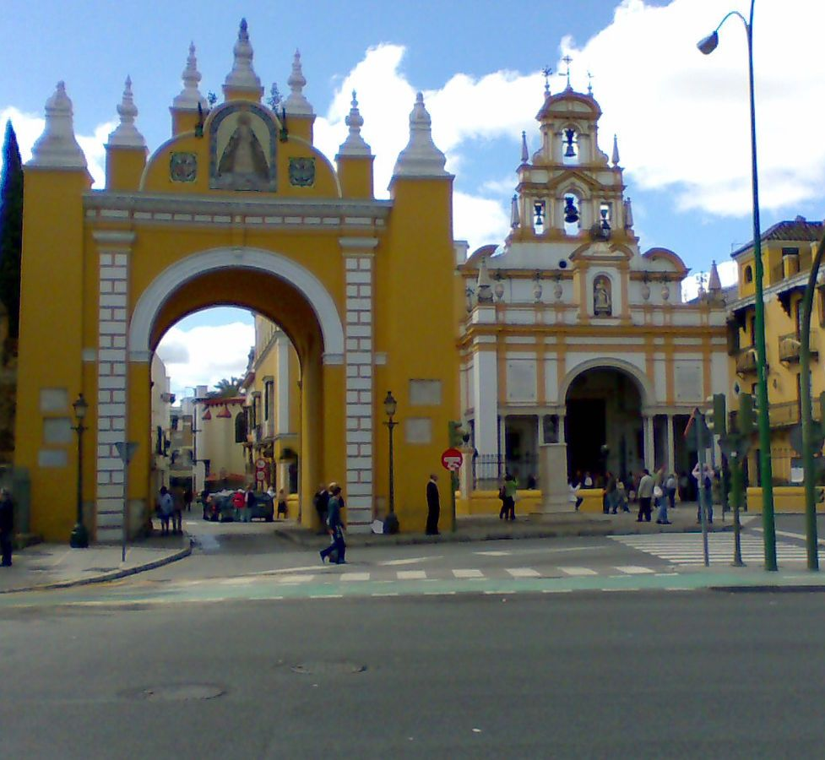
The Other Sevilla
4 The Other Seville
In the evening you may opt for a very special tour of the Other Sevilla, including the Macarena, tapas, and a flamenco show.

Slide 7
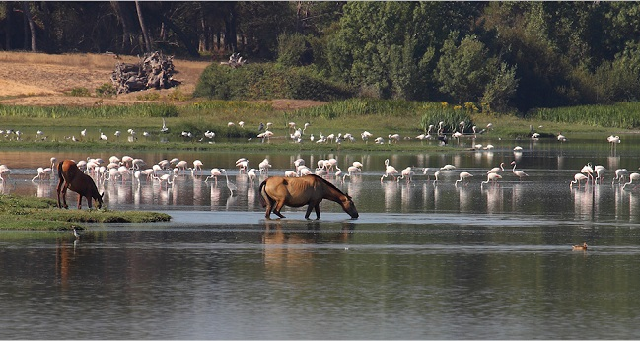
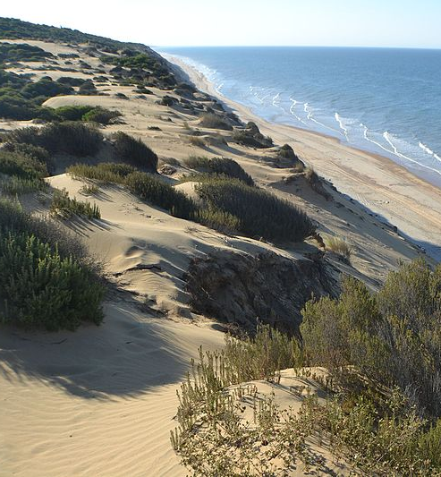
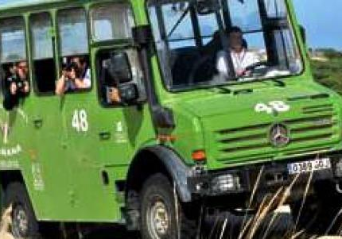
Donana National Park
5 Parque Doñana
An excursion to this remarkable National Park is a rare treat. One of the most important existing wetlands. It’s dunes, birds, horses, and wildlife are unmatched. And this is just the beginning of today’s adventures.

Slide 8
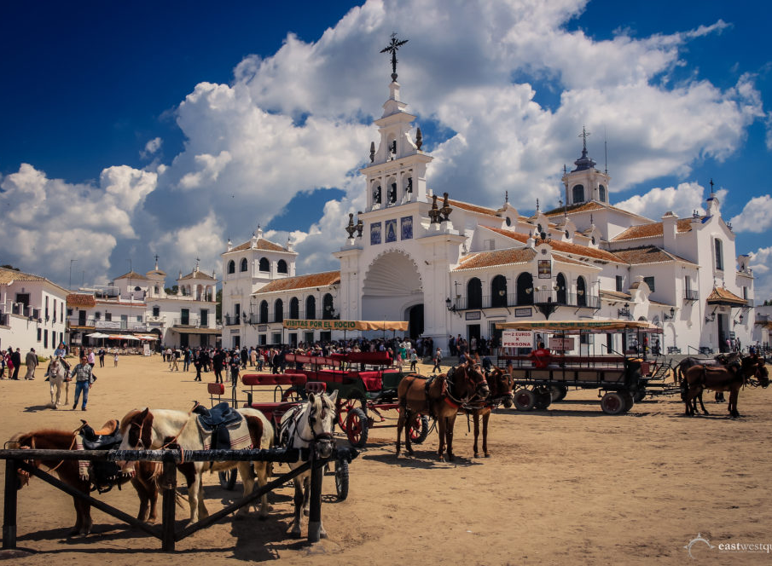
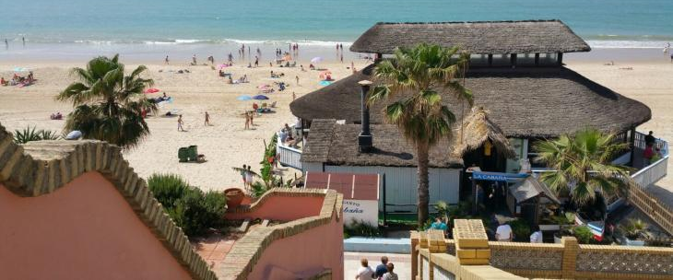
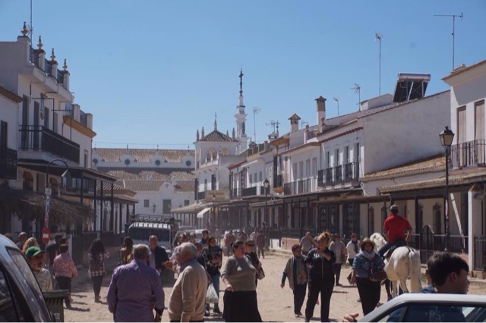
Matalascanas and The Rocio - enchantment
5 Matalascañas and el Rocio
After the Park, what better than a relaxing lunch at one of the nearby beach “chiringuitos”. Enjoy.
With appetites satiated we continue to the Rocio, a magical enchanting town which attracts millions of pilgrims each year. We will visit its Basilica, take a horse and wagon ride through the town and its surroundings, and maybe do some shopping!

Slide 9
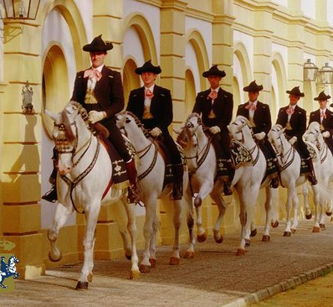
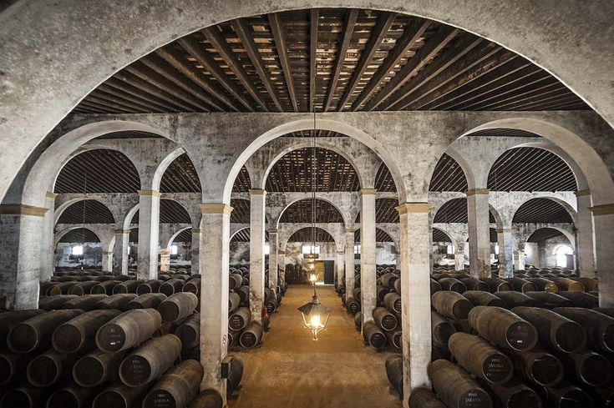
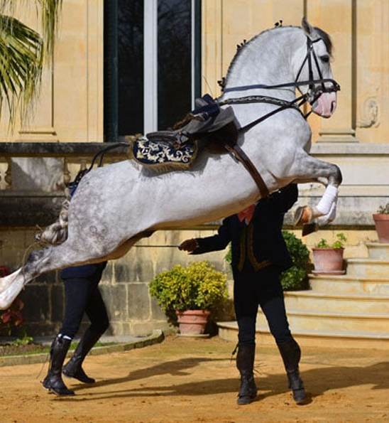
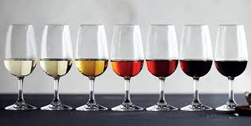
Jerez de la Frontera: Sherry, History, and Andalusian Horses
6 Jerez de la Frontera
Join this unusual and satisfying excursion to Jerez de la Frontera. We will see the magnificent Andalusian horses at the Royal School of the Equestrian Arts, stroll through the lovely town, and have a unique private sherry tasting and tapas lunch at one of Jerez’s top bodegas.
Or remain in Sevilla to explore its depths.

Slide 10
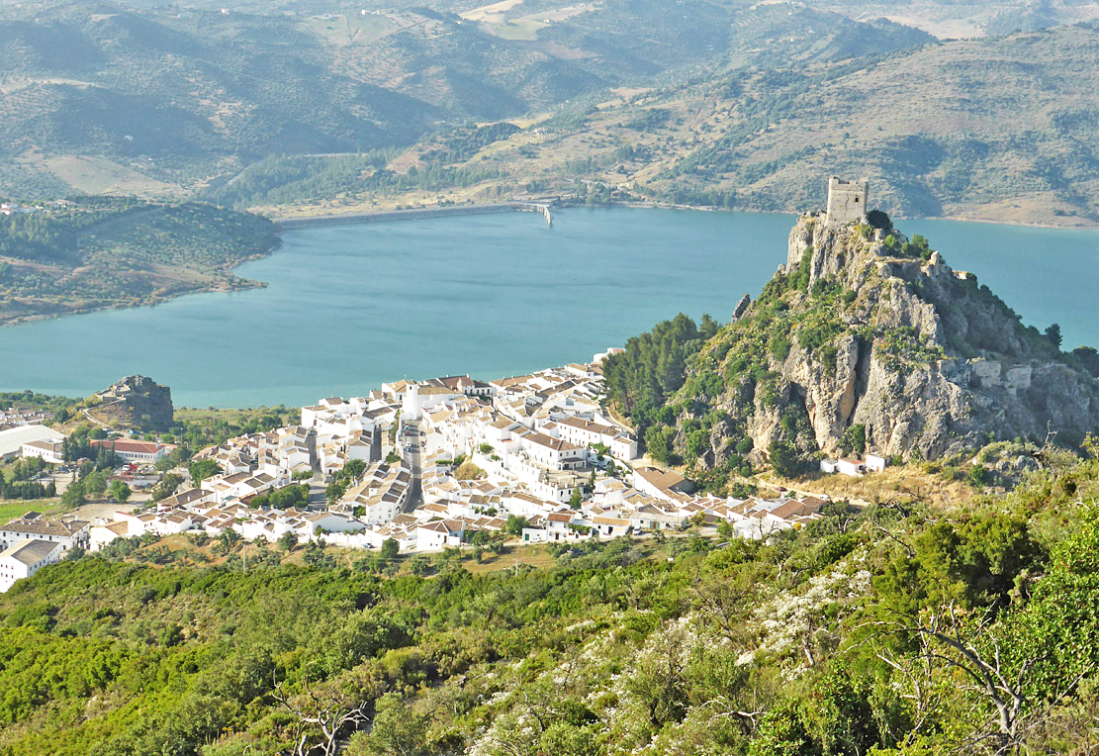
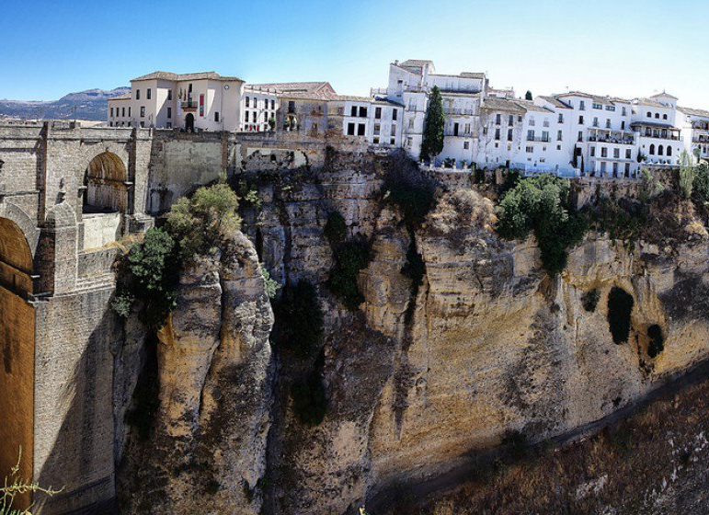
Zahara de la Sierra, Oil Tasting, and Ronda
7 Zahara, Oil Tasting and Ronda
Today we make our way to the city of Granada, and the travel day is more than special.
First stop is Zahara de la Sierra where we will stroll through this lovely “pueblo blanco”, then visit an olive oil producing enterprise where we will taste oils and be treated to a snack of tapas
Next stop, Ronda, one of the most dramatic pueblos blancos. Enjoy the dramatic vistas and charm of the precariously perched town.

Slide 11
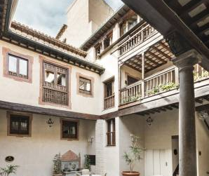
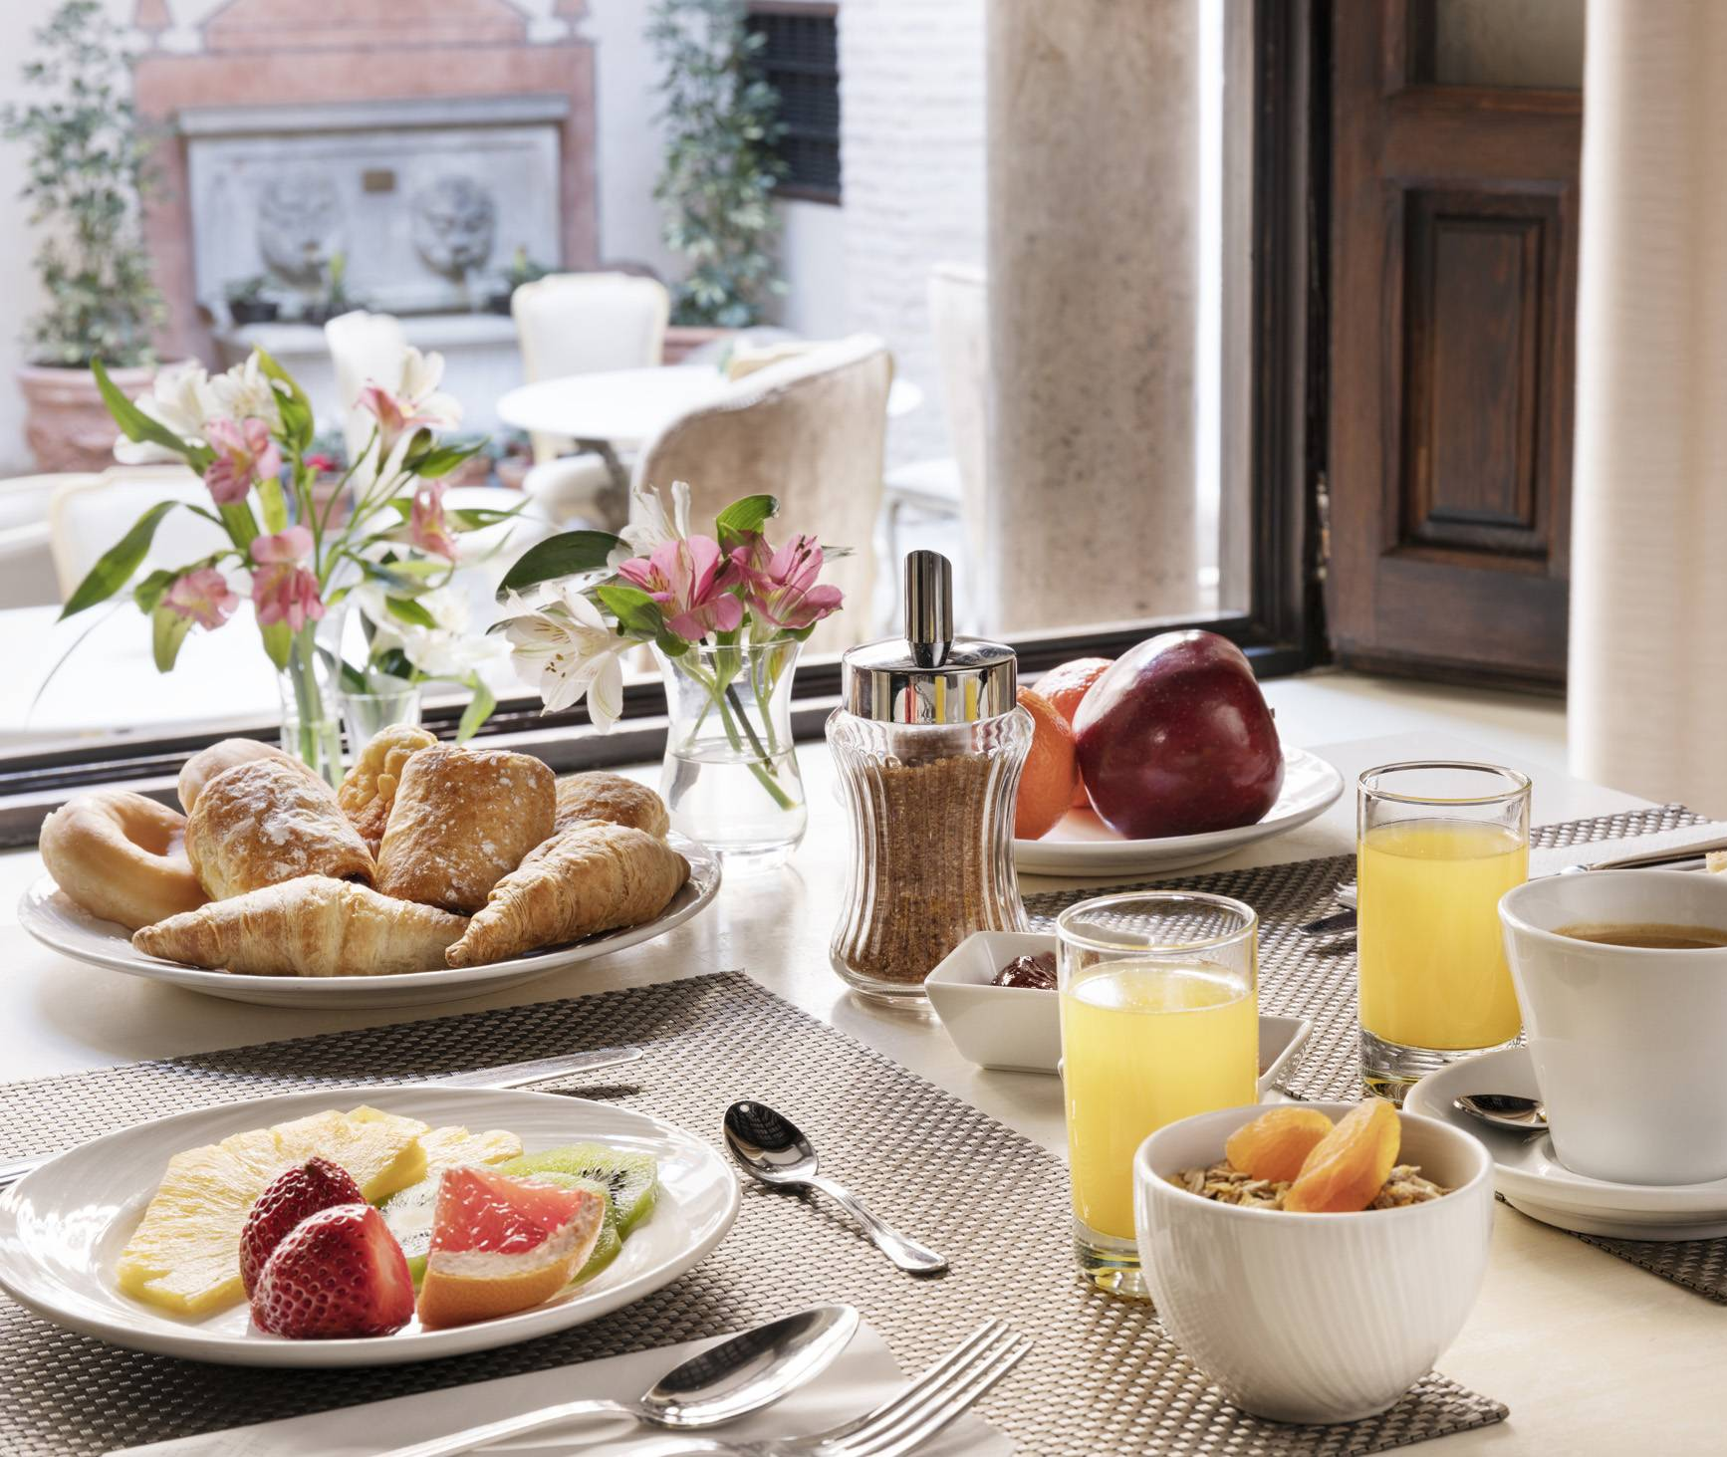
Hotel Casa 1800 Granada
7 Hotel Casa 1800 Granada
Check in to our enchanting hotel for our 2 nights in Granada
Relax, and take a self guided tapas tour.

Slide 12
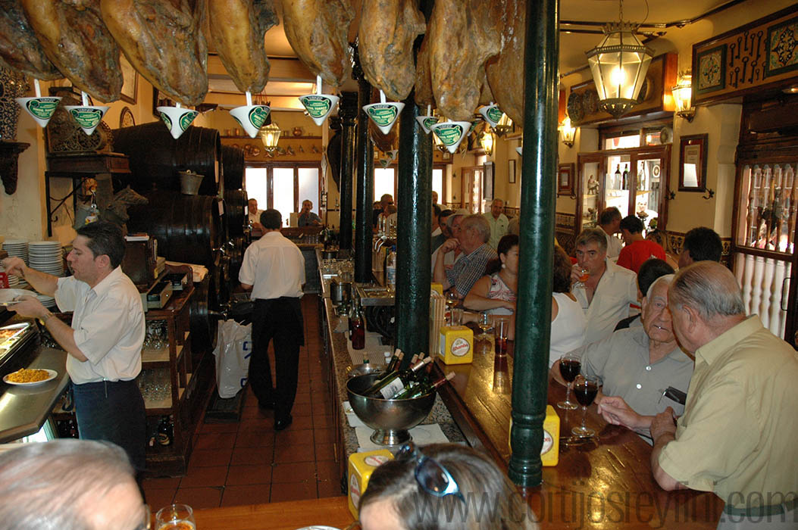
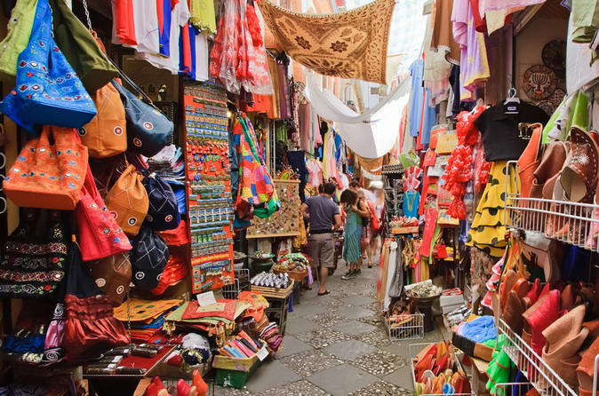
Granada – La Alahambra, Tapas and Sacromonte
8 La Alahambra, Tapas, Sacromonte
We will start the day with a walking tour of some of Granada’s charming neighborhoods after which we will take some time for a Grenadine lunch.
We will be taken up the hill for our unforgettable private tour of the magnificent Alahambra and its gardens.
Later, join us for a tour of Sacromonte, the famous gypsy caves, and their flamenco. Or spend time exploring more of Granada, one of the tapa capitals of Spain.

Slide 13
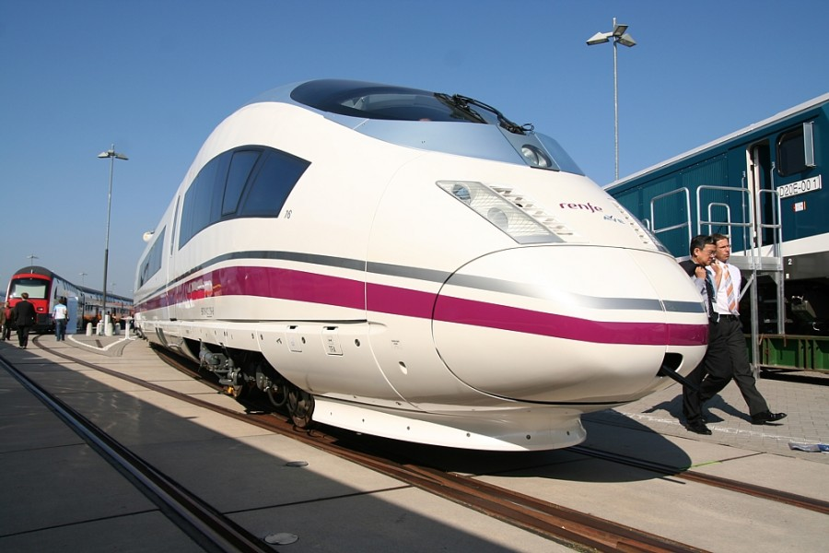
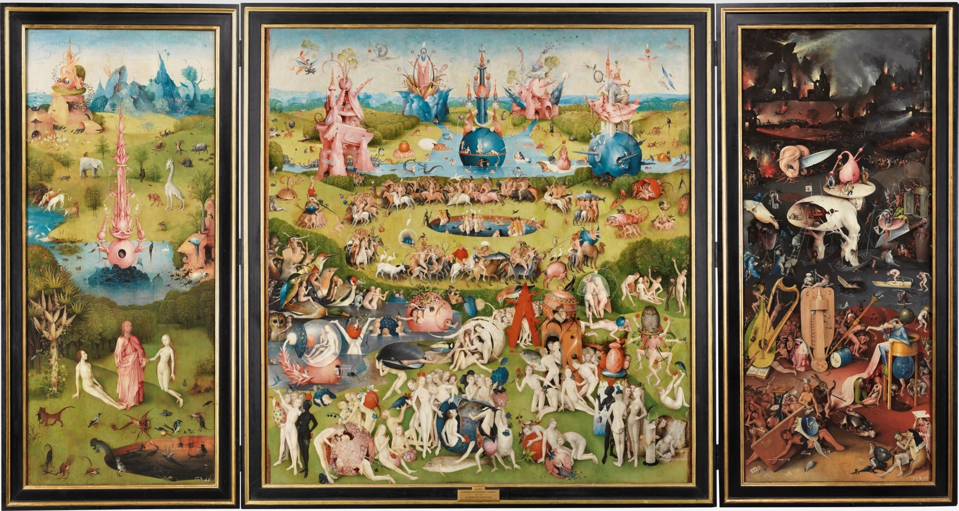
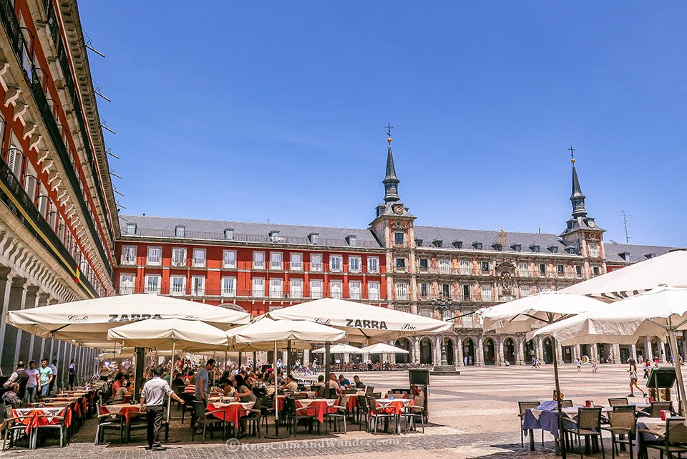
Granada – La Alahambra, Tapas and Sacromonte
9 An afternoon in Madrid
Today we will travel back to Madrid where we can arrange visits to the Prado or other one of a kind visits that may be mad e in the capital city.
Enjoy one of the plethora of world class Madrileno restaurants or watch the street action from a terrace in the Plaza Mayor.

Slide 14
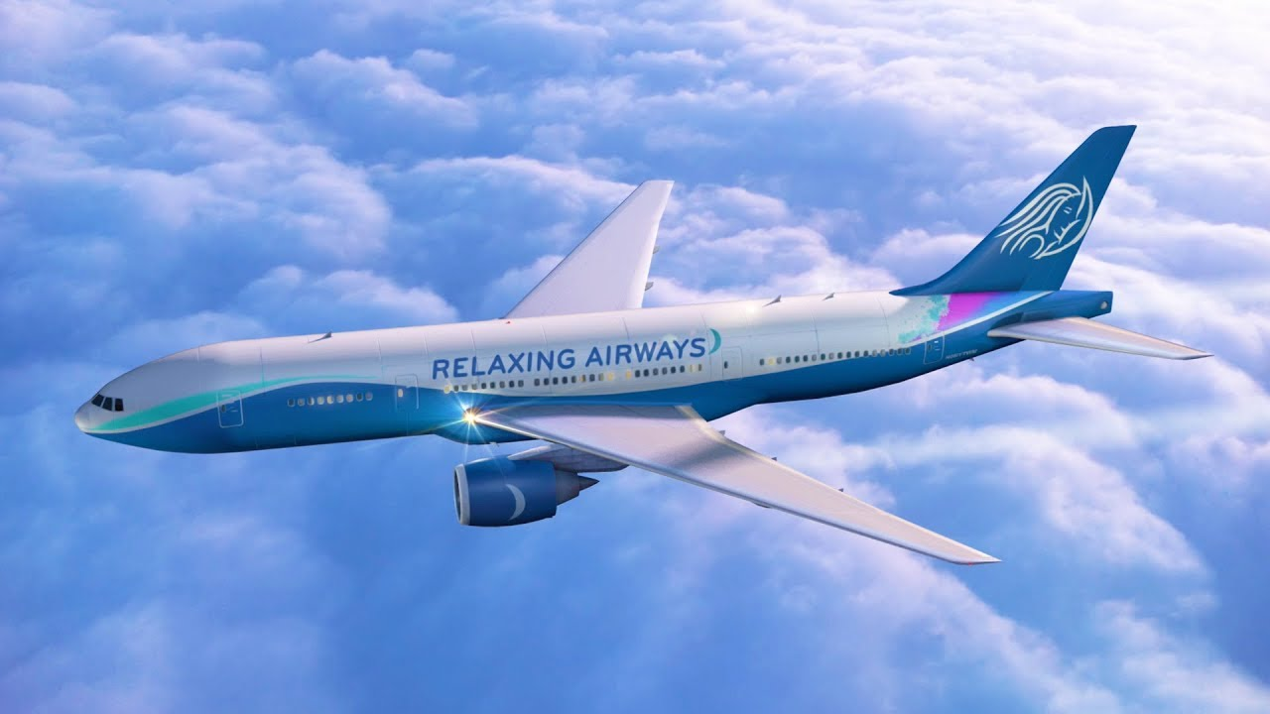
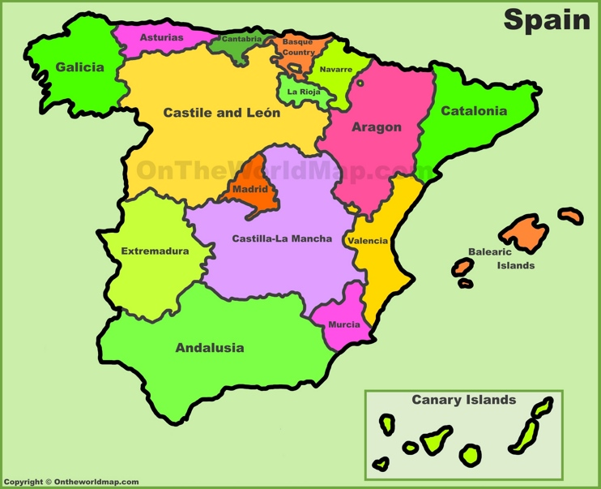
10 All good things come to an end
After breakfast today our tour ends and you will begin your travels home, or continue your travels in Spain and Europe. Buen Viaje!

